Slide 1
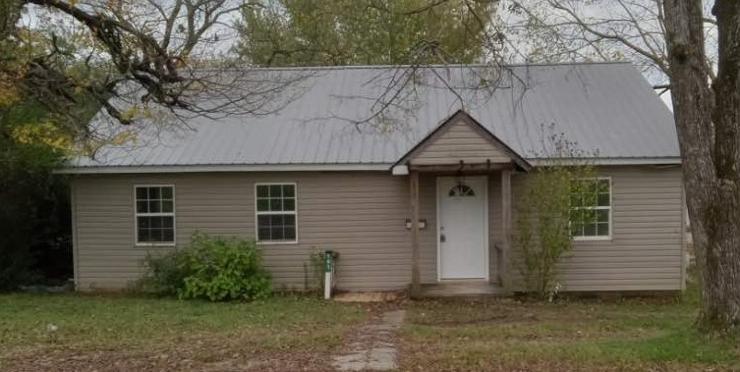
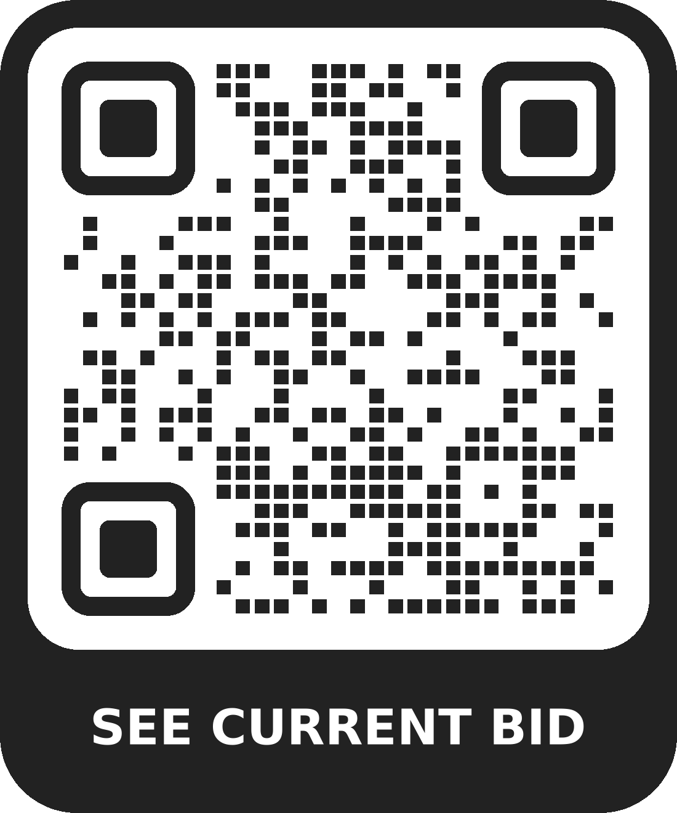
Online Only
Bidding
Residential Property Auction
141 Highland St, Bruceton, TN 38317
Register to bid @www.bidjds.com!
Open House:
November 30th – 12:00
Approx 1,100 sq ft living space
2 Bedrooms
1 Bathroom
Fully remodeled!
Corner lot
Bidding closes
Tuesday Dec 3rd
7:00PM CT/8:00PM ET
Questions?
Call 865-264-4641
See more at
www.bidjds.com
Auctioneer – Jason Deel TAL # 6826
Auctioneer – Brandon Presley TAL # 7424
10% Buyer’s Premium for Real Estate
10% Down on Auction Day

Slide 2
